Slide 1
Lab 1. Functions

Slide 2
Note
Before doing this lab, I assume that you have already finished homework tasks appended after lecture 1 slides
If so, proceed to the following slide.

Slide 3
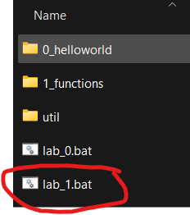
Homework 1 (follow exactly)
Download the lab1.zip file from GitHub.
Place it to your labpack folder
Unzip the lab1.zip by right click,
“show more options” then “extract here”
Delete lab1.zip
Double click the lab1.bat
Do not proceed unless your labpack folder looks exactly like this.

Slide 4
Homework 1
Open heyjude.c
Trace the execution of the file, step by step, using the debugger.

Slide 5
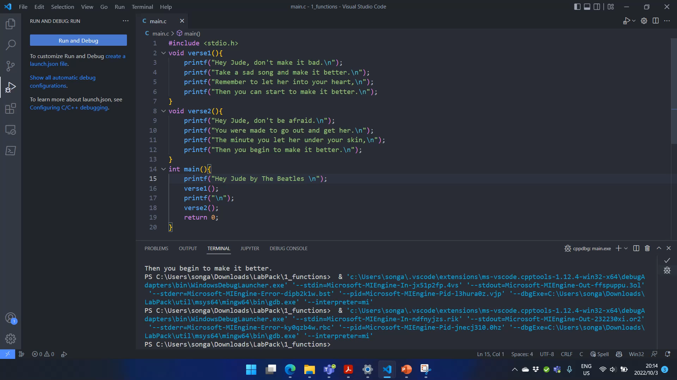
To enter a function, you need to click “Step Into” (F11), rather than click “Step Over” (F10).
If you “step over” a function, the debugger will not enter the function while it is being executed.

Slide 6
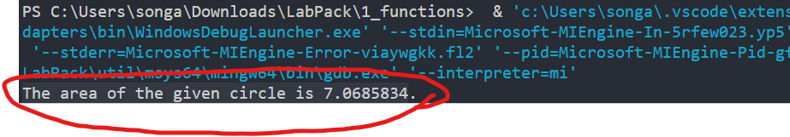
Homework 2
Study the “calculate_circumference” example in the lecture slides. Open file “area.c”.
Write a function named “calculate_area” which returns the area of a circle given a radius.
Your function should have 1 input and 1 output.
Write a “main” function that calls “calculate_area” and print out the returned area.
The printout should read:
“The area of the give circle is X.XXXXXXX.”

Slide 7
Homework 3
Open file: “goofookoo.c”
Do NOT run the code for now.
Read the code and write down the output of this program on a paper.
Now, run the code, and check your answer. Did you get it right? Use the debugger to trace the execution.
This was a last year’s written exam question.

Slide 8
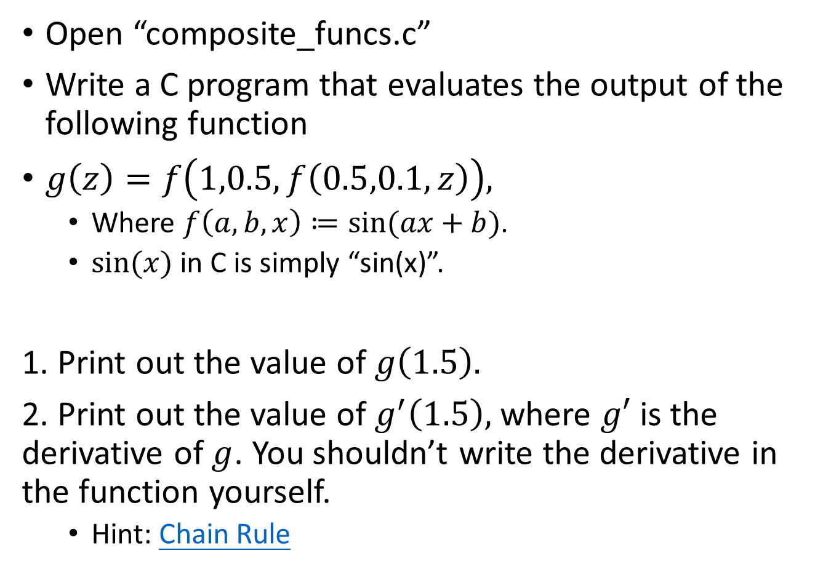
Homework 4 (submit this)
Open “composite_funcs.c”
Write a C program that evaluates the output of the following function
$g\left(z\right)=f\left(1,0.5,f\left(0.5,0.1,z\right)\right),$
Where $f\left(a,b,x\right)≔sin⁡(ax+b)$.
$sin⁡(x)$ in C is simply “sin(x)”.
1. Print out the value of $g\left(1.5\right).$
2. Print out the value of$g^{′}\left(1.5\right),$ where $g′$ is the derivative of $g$. You shouldn’t write the derivative in the function yourself.
Hint: Chain Rule

